Slide 1
EarthCARE ESA Data Products
Tobias Wehr
tobias.wehr@esa.int
16/02/2022

Slide 2
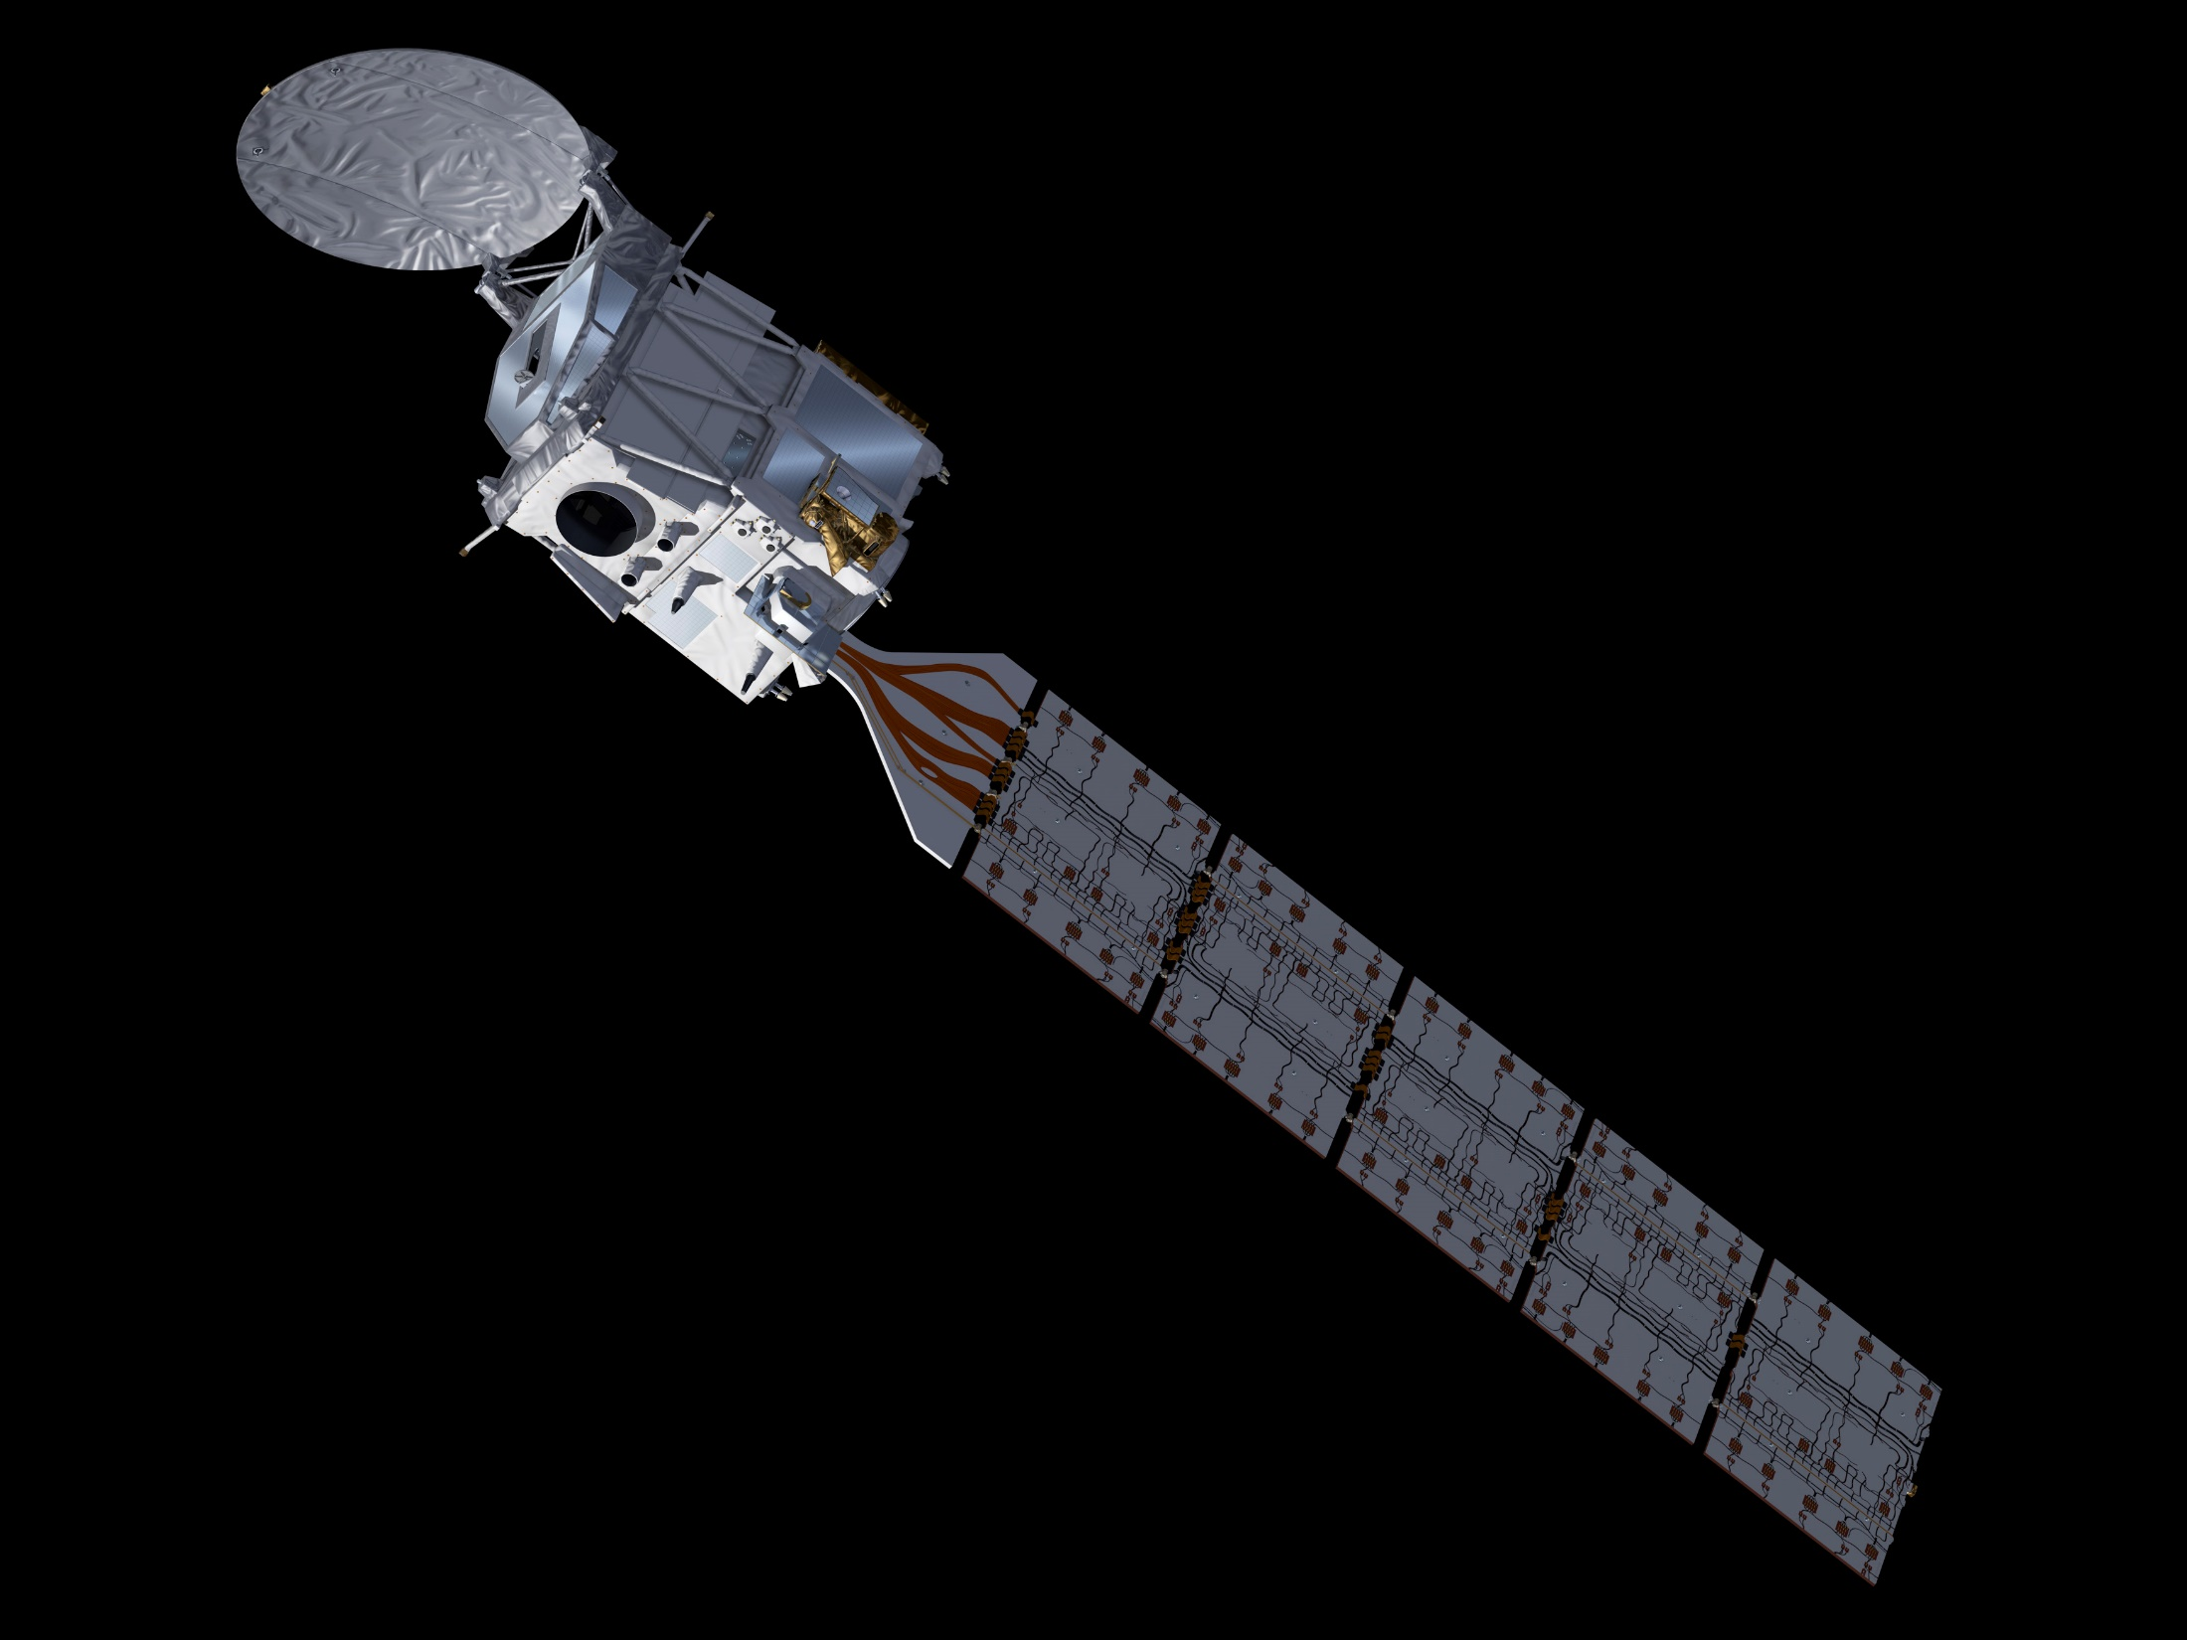
CPR – Cloud Profiling Radar W-Band with Doppler
ATLID – Atmospheric Lidar 355 nm HSRL with depol. channel
MSI – Multi-Spectral Imager 4 solar, 3 thermal channels
BBR – Broad-Band Radiometer 3 FoV (forward, nadir, backwards), broadband solar and thermal channel
EarthCARE
Observations:
Cloud profiles (ice, liquid, mixed), cloud coverage, precipitation
Aerosol profiles
Broad-band Solar & Thermal Radiation
Satellite and Payload
Sun-sync. orbit at 393 km, 14:00 hours descending node
UV Lidar with high spectral resolution receiver
W-band Cloud Radar with Doppler (contribution JAXA)
Imager and Broad-Band Radiometer
Launch October 2023
Notes:
high confidence that system integration can be completed this summer, then system testing at ESTEC for about a year, then launch campaign. high confidence Oct 2023 launch. Hopefully, EarthCARE will come to ESTEC in June.

Slide 3
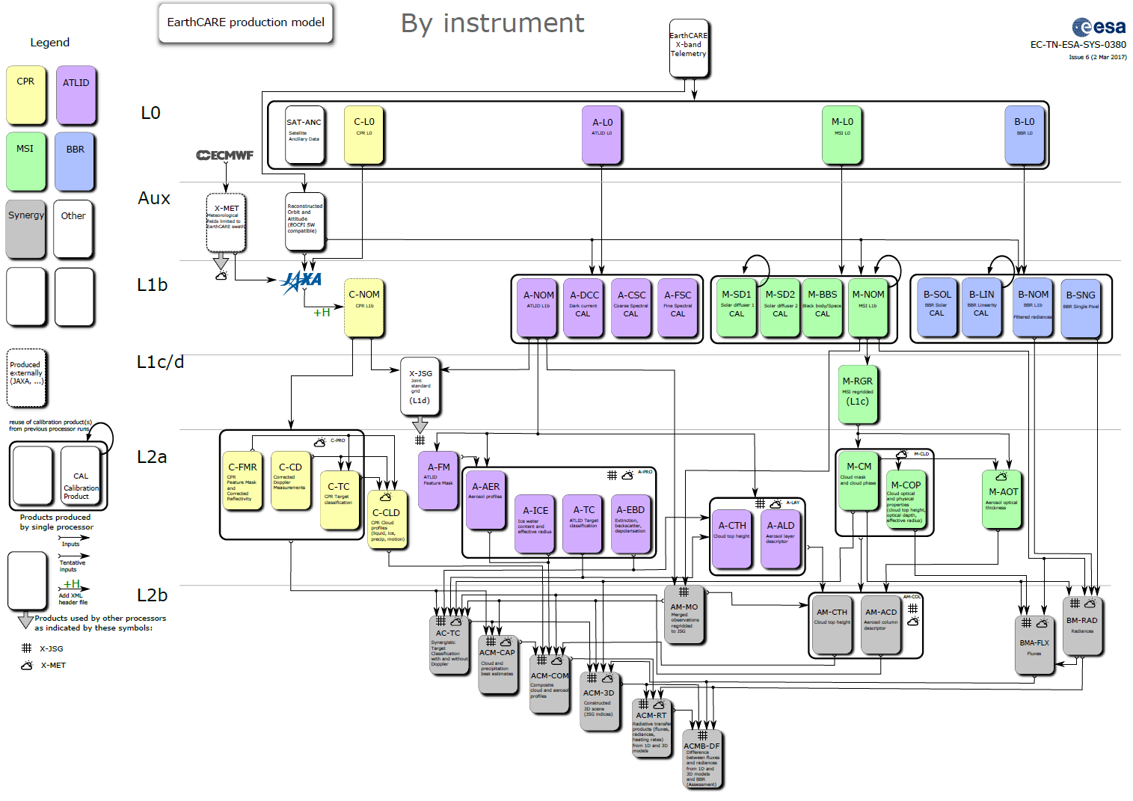
Nomenclature of data products
YYY-ZZZ YYY: instrument IDs, ZZZ: content reference
Examples:
A-FM ATLID-derived Feature Mask
AM-CTH ATLID & MSI-derived Cloud Top Height
Exception: supporting products X-MET & X-JSG
ESA L2a
ESA L2b
3

Slide 4
EarthCARE Data Product Tree
ESA data products will be produced operationally by the ESA ground segment located at ESRIN.
JAXA data products fall in two categories:
Standard Products: produced and released by JAXA Mission Operation System:
(1) CPR echo and cloud products; (2) ATLID feature & target mask, aerosol & cloud products, PBL height; (3) MSI cloud products; (4) CPR-ATLID synergistic cloud products; (5) CPR-ATLID-MSI synergistic cloud products; (6) Four-sensor synergy radiative products.
Research Products: processed by either JAXA/EORC or co-operating Japanese Laboratories, are single or multi-sensor cloud, aerosol, precipitation, snow and air motion products.
L0 and L1 calibration products not distributed to regular users
ESA L2a
ESA L2a
geophysical retrievals per instrument
→ 14 products
ESA L2b
ESA L2b
synergistic retrievals
→ 11 products
4

Slide 5
EarthCARE Data Product Tree
ESA data products will be produced operationally by the ESA ground segment located at ESRIN.
JAXA data products fall in two categories:
Standard Products: produced and released by JAXA Mission Operation System:
(1) CPR echo and cloud products; (2) ATLID feature & target mask, aerosol & cloud products, PBL height; (3) MSI cloud products; (4) CPR-ATLID synergistic cloud products; (5) CPR-ATLID-MSI synergistic cloud products; (6) Four-sensor synergy radiative products.
Research Products: processed by either JAXA/EORC or co-operating Japanese Laboratories, are single or multi-sensor cloud, aerosol, precipitation, snow and air motion products.
X-MET and X-JSG Products
X-MET:
meteorological forecast data collocated with EarthCARE swath
used for data product generation
provided by ECMWF
L0 and L1 calibration products not distributed to regular users
X-JSG: Joint Standard Grid
used as retrieval grid for many L2 data products
Definition:
vertical, following lidar: approx. 103 m
along-track, following radar*: approx. 1 km *2 radar pixels
across-track resolution: fixed 1 km
ESA L2a
ESA L2b
5

Slide 6
EarthCARE Data Product Tree
ESA data products will be produced operationally by the ESA ground segment located at ESRIN.
JAXA data products fall in two categories:
Standard Products: produced and released by JAXA Mission Operation System:
(1) CPR echo and cloud products; (2) ATLID feature & target mask, aerosol & cloud products, PBL height; (3) MSI cloud products; (4) CPR-ATLID synergistic cloud products; (5) CPR-ATLID-MSI synergistic cloud products; (6) Four-sensor synergy radiative products.
Research Products: processed by either JAXA/EORC or co-operating Japanese Laboratories, are single or multi-sensor cloud, aerosol, precipitation, snow and air motion products.
Level 1 Products
C-NOM:
radar reflectivity (dBZ)
Doppler velocity (m/s)
A-NOM:
attenuated backscatter in
“Mie” channel, “Rayleigh” channel, cross-polar channel
L0 and L1 calibration products not distributed to regular users
M-NOM:
radiances in solar channels
T_{B} in thermal channels
M-RGR:
radiances in solar channels, re-gridded
T_{B} in thermal channels, re-gridded
Since the seven channels of MSI are not accurately aligned, this product uses one (selectable) channel as reference and spatially re-samples all other channels to the reference channels, so that all channels are fully aligned.
(Note: on the MSI own grid, not on the JSG.)
B-NOM:
Filtered SW and LW radiances
resolutions: 10km x 10km (standard)
5km x 10km (small)
17/28km x 10km (full)
B-SNG:
Filtered SW and LW radiances
high resolution corresponding to along-track sampling and detector resolution → usage: customise spatial resolution
Note: These data products contain filtered radiances, which are scientifically not directly useable, before unfiltering has happened. Therefore: science users advised to use BM-RAD product!
ESA L2a
ESA L2b
6

Slide 7
CPR Level 1b (JAXA)
Radar reflectivity and Doppler velocity profiles
ATLID Level 1b (ESA)
Attenuated backscatter in
Rayleigh channel
Co-polar Mie channel
Cross-polar Mie channel
MSI Level 1b/c (ESA)
TOA radiances for four solar channels, TOA brightness temperatures for three thermal channels
CPR Level 2a
Radar echo product, feature mask, cloud type, liquid and ice cloud properties, vertical motion, rain and snow estimates, ...
ATLID Level 2a
Feature mask and target classification, extinction, backscatter & depol. profiles, aerosol properties, ice cloud properties, ...
MSI Level 2a
Cloud mask, cloud micro-physical parameters, cloud top height, aerosol parameters, ...
Synergistic Level 2b
1. Target classification
2. Cloud & aer. prof. at x-sec
EarthCARE Data Production Model

Slide 8
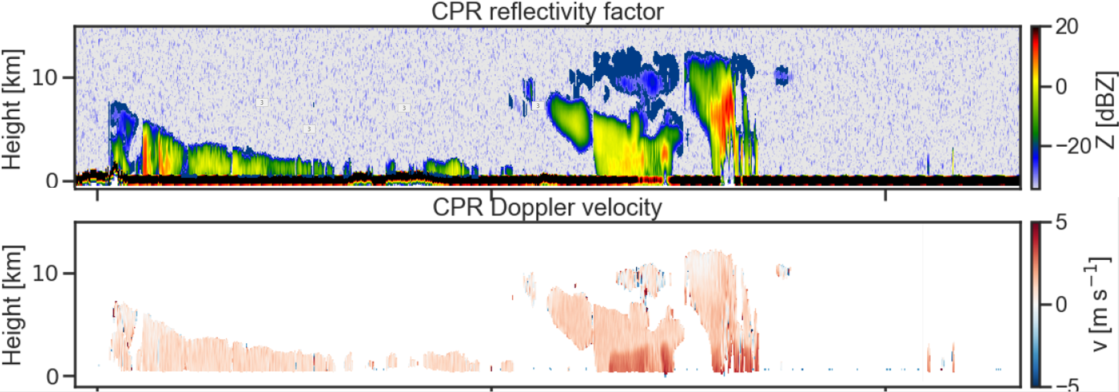
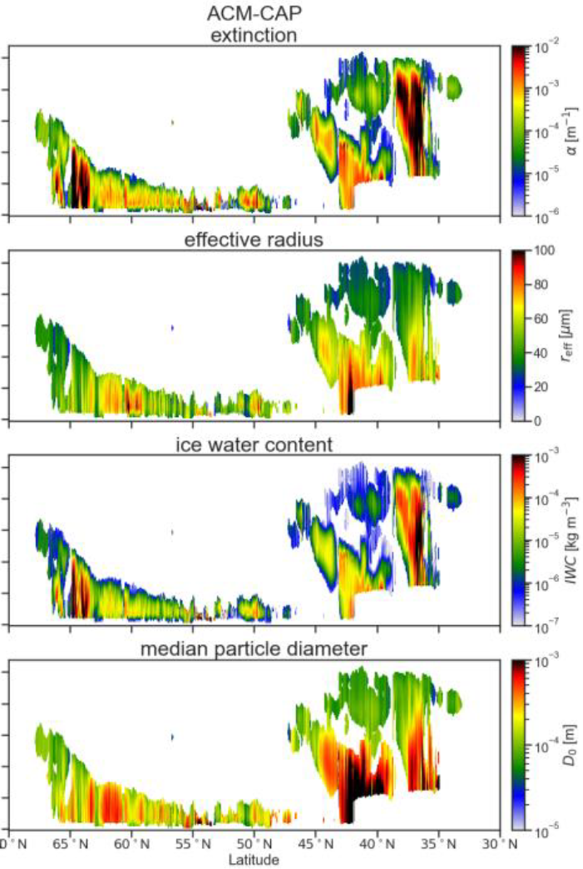
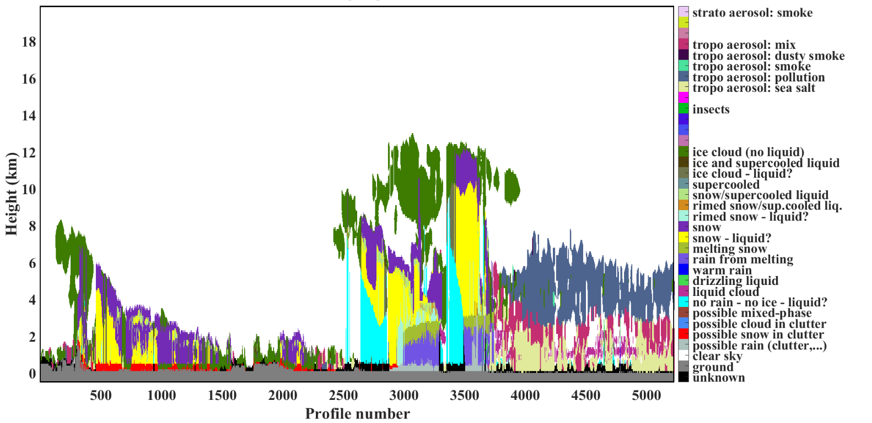
CPR Level 1b (JAXA)
Radar reflectivity and Doppler velocity profiles
ATLID Level 1b (ESA)
Attenuated backscatter in
Rayleigh channel
Co-polar Mie channel
Cross-polar Mie channel
CAPTIVATE Algorithm
Synergistic Retrievals
MSI Level 1b/c (ESA)
TOA radiances for four solar channels, TOA brightness temperatures for three thermal channels
CPR Level 2a
Radar echo product, feature mask, cloud type, liquid and ice cloud properties, vertical motion, rain and snow estimates, ...
ATLID Level 2a
Feature mask and target classification, extinction, backscatter & depol. profiles, aerosol properties, ice cloud properties, ...
MSI Level 2a
Cloud mask, cloud micro-physical parameters, cloud top height, aerosol parameters, ...
Synergistic Level 2b
1. Target classification
2. Cloud & aer. prof. at x-sec
EarthCARE Data Production Model
synergistic target classification
acknowledgements: KNMI, LATMOS, ECMWF
Notes:
ATLID Level 1 is noisy, difficult to detect weak features – it is not recommended to use a threshold-based detection of features, instead, use A-FM (image processing methods to identify features)

Slide 9
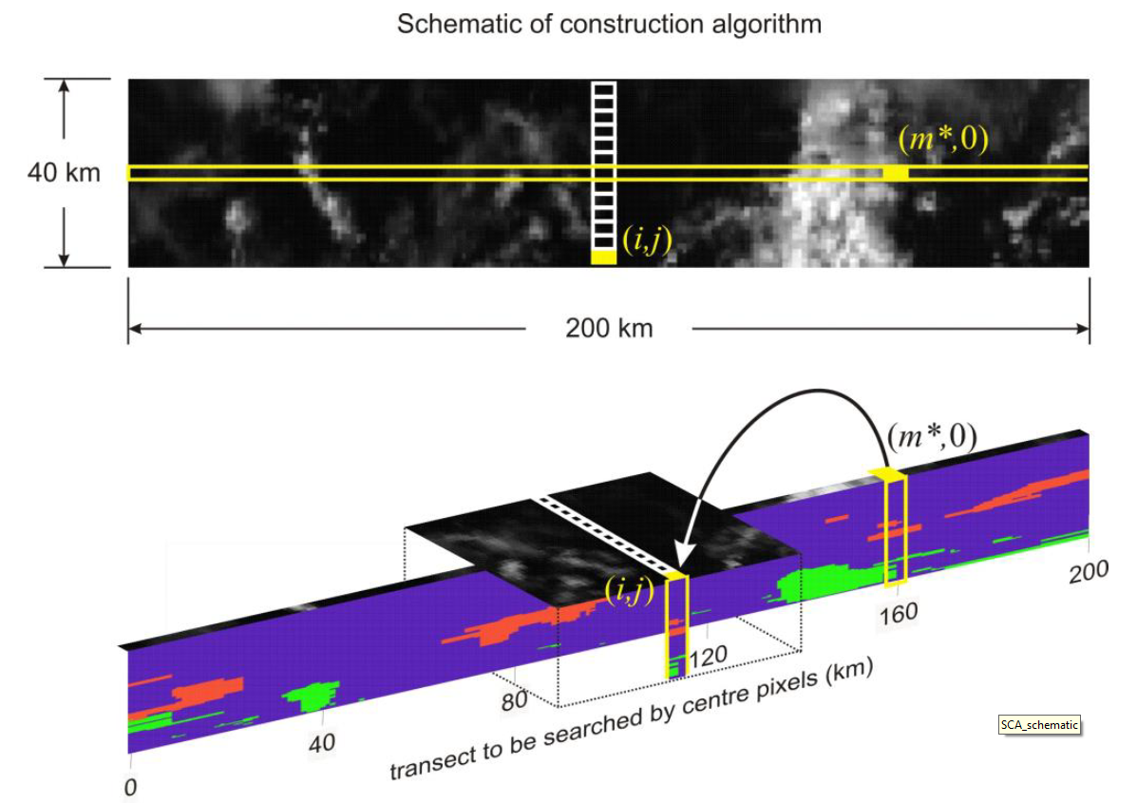
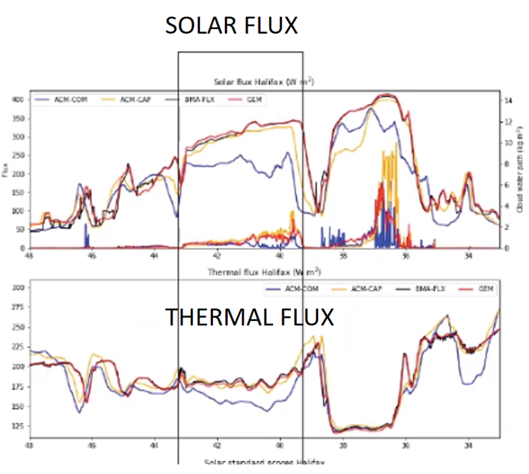
CPR Level 1b (JAXA)
Radar reflectivity and Doppler velocity profiles
ATLID Level 1b (ESA)
Attenuated backscatter in
Rayleigh channel
Co-polar Mie channel
Cross-polar Mie channel
MSI Level 1b/c (ESA)
TOA radiances for four solar channels, TOA brightness temperatures for three thermal channels
CPR Level 2a
Radar echo product, feature mask, cloud type, liquid and ice cloud properties, vertical motion, rain and snow estimates, ...
ATLID Level 2a
Feature mask and target classification, extinction, backscatter & depol. profiles, aerosol properties, ice cloud properties, ...
MSI Level 2a
Cloud mask, cloud micro-physical parameters, cloud top height, aerosol parameters, ...
Synergistic Level 2b
1. Target classification
2. Cloud & aer. prof. at x-sec
EarthCARE Data Production Model
3D Scenes Construction
Expand syn. retrievals across-track using MSI; ≈40km wide
acknowledgements: Environment and Climate Change Canada
Radiative Transfer Products
calculated radiances, fluxes, heating rate profiles
Notes:
Radiative transfer on three-dimensional scenes of cloud/aerosol/precip information retrieved from ATLID, CPR, MSI → calculate radiances, fluxes, heating rates (ACM-RT product). TOA radiances and flux are then compared to BBR observations (BM-RAD, BMA-FLX). The result of the comparison is reported in the ACMB-DF product (in terms of probability functions). Note, ACM-RT does not make any use of BBR information, therefore, the comparison to BM-RAD and BMA-FLX is independent. The purpose of this is to evaluate the quality of the cloud/aerosol/precip retrievals against the BBR measurements.

Slide 10
CPR Level 1b (JAXA)
Radar reflectivity and Doppler velocity profiles
ATLID Level 1b (ESA)
Attenuated backscatter in
Rayleigh channel
Co-polar Mie channel
Cross-polar Mie channel
MSI Level 1b/c (ESA)
TOA radiances for four solar channels, TOA brightness temperatures for three thermal channels
BBR Level 1b (ESA)
Filtered TOA short-wave and total-wave radiances
CPR Level 2a
Radar echo product, feature mask, cloud type, liquid and ice cloud properties, vertical motion, rain and snow estimates, ...
ATLID Level 2a
Feature mask and target classification, extinction, backscatter & depol. profiles, aerosol properties, ice cloud properties, ...
MSI Level 2a
Cloud mask, cloud micro-physical parameters, cloud top height, aerosol parameters, ...
BBR Level 2a
Unfiltered top-of-atmosphere radiances, short-wave and long-wave fluxes
BBR Level 2b: enhanced products using MSI
Synergistic Level 2b
1. Target classification
2. Cloud & aer. prof. at x-sec
EarthCARE Data Production Model
3D Scenes Construction
Expand syn. retrievals across-track using MSI; ≈40km wide
Assessment
Comparison of calculated fluxes and radiances to BBR observations
Radiative Transfer Products
calculated radiances, fluxes, heating rate profiles
Slide 10

Slide 11
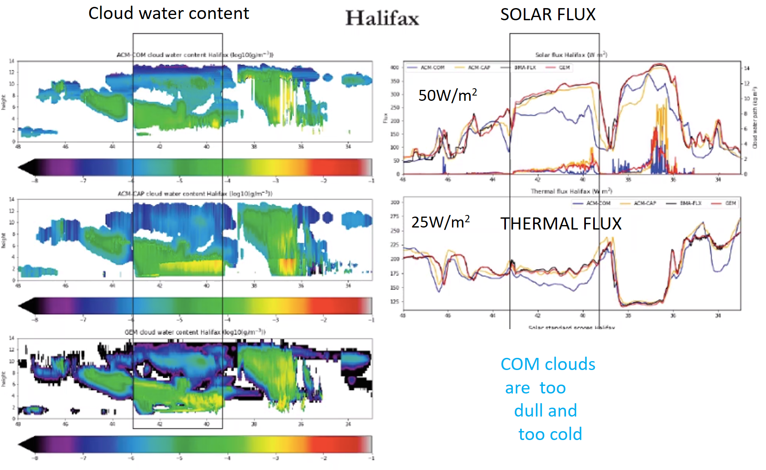
Test Scene
(“Halifax”)
Retrievals and “Closure”
Example of work in progress
Reconstructed cloud scene
based on radar-only + lidar-only + imager-only cloud retrievals
(“Composite” product)
FLUX IN BLUE
Synergistically retrieved
cloud scene, CAPTIVATE
algorithm (Opt. Estimation with complex state vector)
FLUX IN YELLOW
Model truth (Canadian
Weather Model GEM)
FLUX IN RED
→ “Composite” clouds are too dull and too cold
Acknowledgement
R. Hogan, S. Mason, H. Barker, Y. Cole, Z. Qu, D. Donovan
11

Slide 12
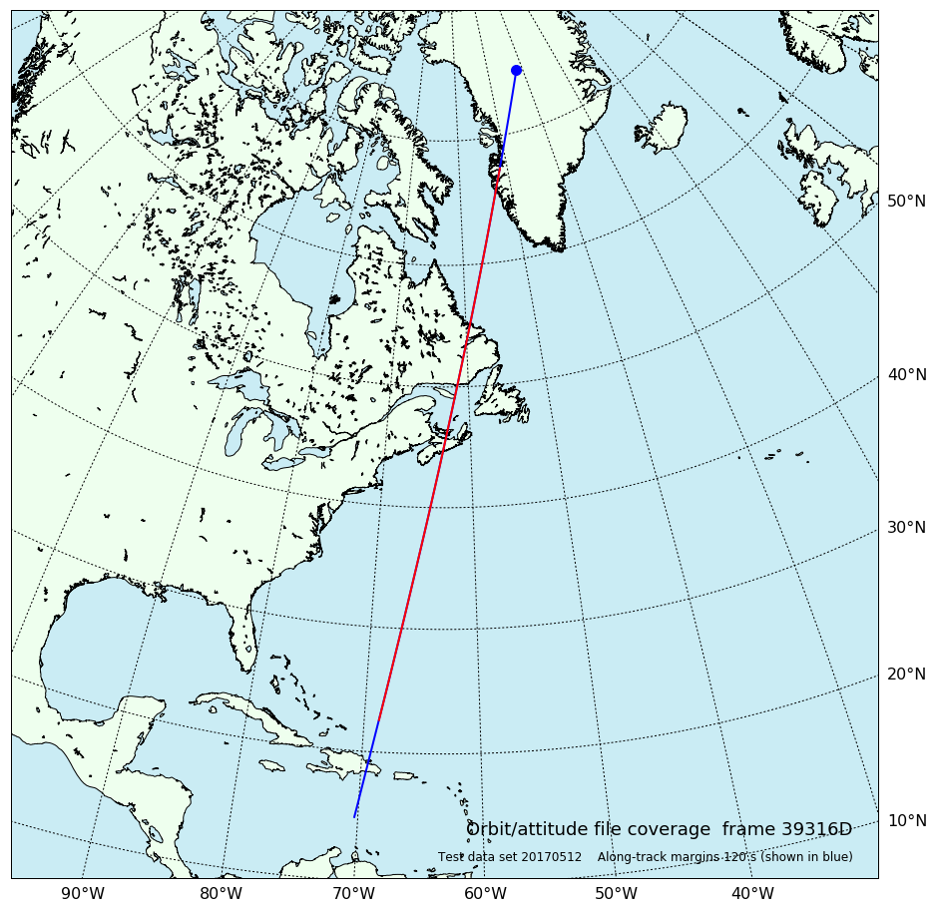
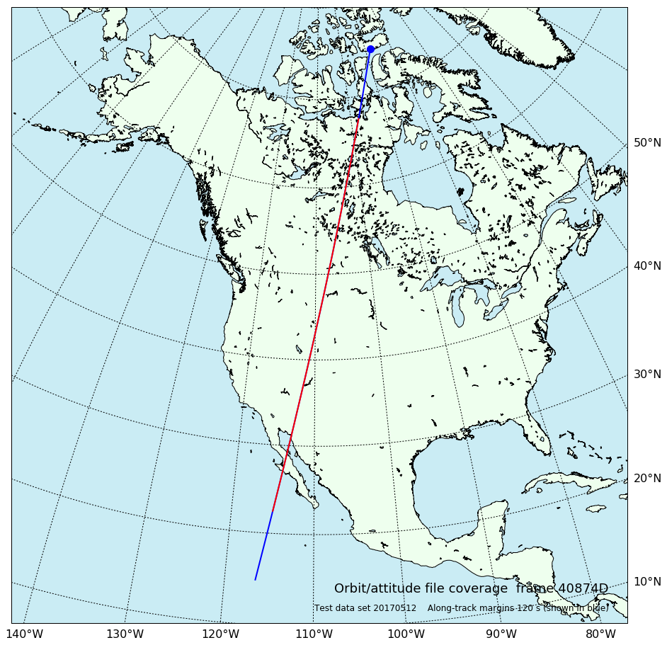
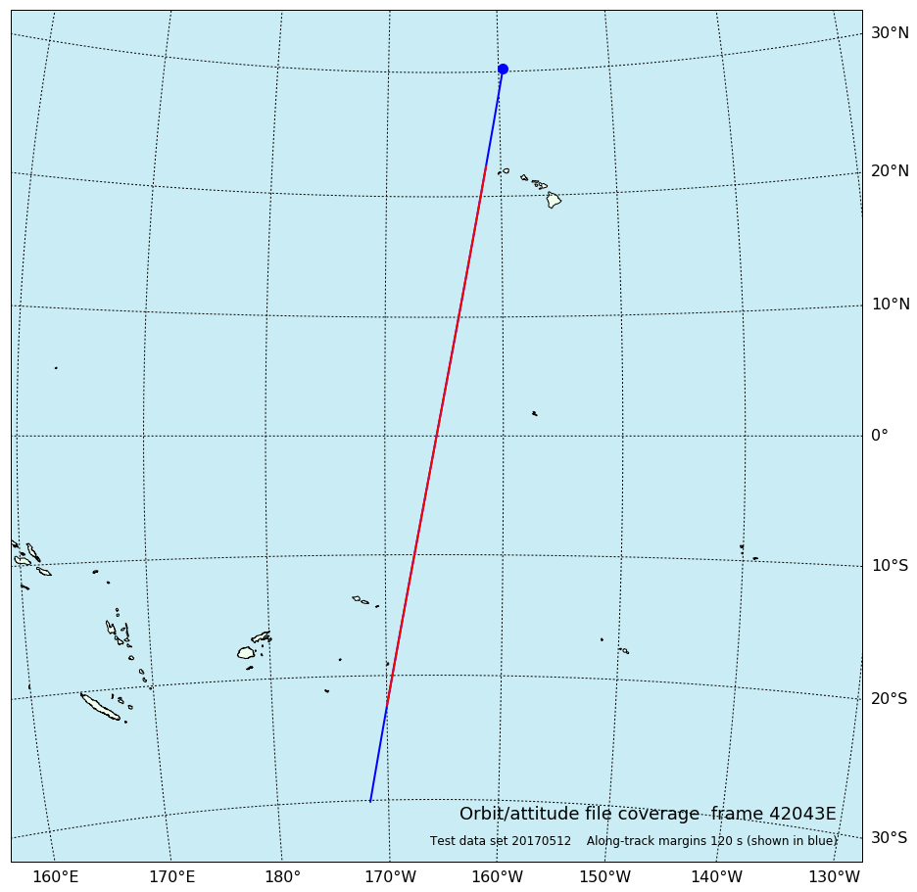
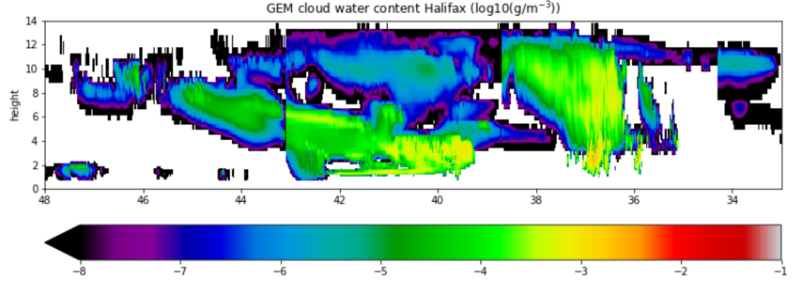
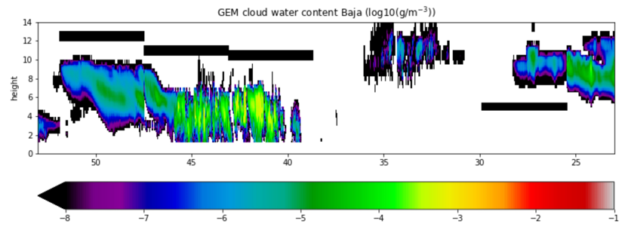
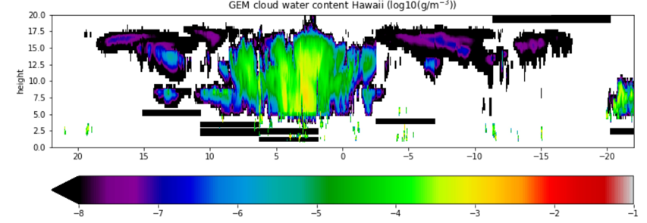
Algorithm testing
Three high-resolution scenes from the Canadian GEM model have been generated
“Halifax” scene “Baja” scene “Hawaii” scene
Test Data are available for the three test scenes
Level 2 products produced by European/Canadian team (based on simulated Level 1 data produced by science team)
Level 1 data produced by ESA processors
A-NOM, M-NOM, M-RGR, B-NOM, B-SNG
(some issues to be resolved, not yet chained with Level 2 processors in production model)
Data available on ftp account – request access from ESA
However, recommended to wait for a few months until Level 1–Level 2 chain completed!
Level 2 Algorithm Theoretical Basis Descriptions to be published in Atmospheric Measurement Techniques Special Issue on “EarthCARE Level 2 algorithms and data products” → paper submission target is June 2022

Slide 13
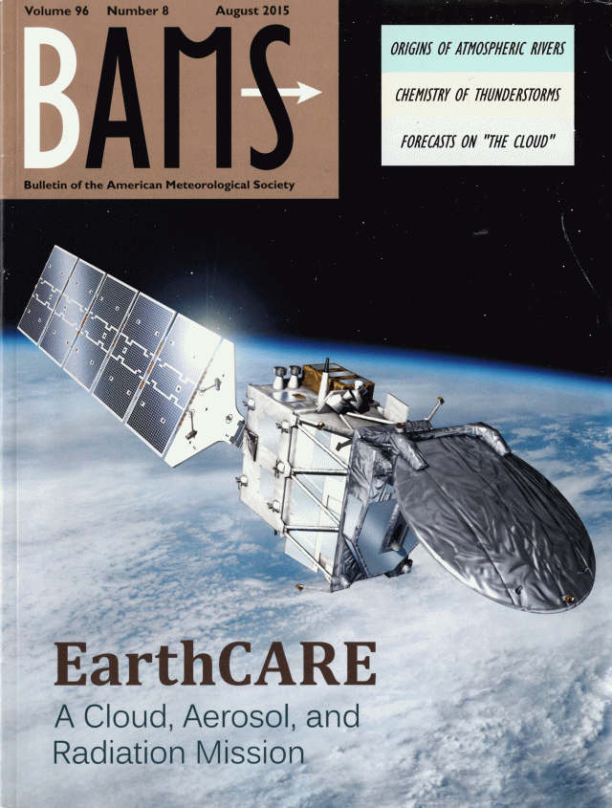
Acknowledgments
The EarthCARE Joint Mission Advisory Group
Co-chairs: A.J. Illingworth, H. Okamoto
Members: L. Baldini, A. Battaglia, H. Chepfer, N. Clerbaux, J. Cole, J. Delanoë, D. Donovan, J. Fischer, S. Groß, R. Hogan, T.Y. Nakajima, T. Nishizawa, Y. Ohno, M. Satoh, K. Suzuki, N. Takahashi, U. Wandinger
Observers: S. Kato, G. Stephens, B. Stevens, D. Vane, D. Winker
Level 2 Team
ATLID retrievals G.-J. van Zadelhoff, D. Donovan(KNMI, Netherlands)
CPR products P. Kollias, B. Puigdomenech (McGill University, Canada); A. Battaglia (University of Torino, Italy)
MSI retrievals A. Hünerbein, S. Bley (TROPOS, Germany); N. Docter, R. Preusker, J. Fischer (Free University of Berlin, Germany)
BBR radiances and estimated fluxes N. Clerbaux, A. Velazquez, E. Baudrez (Royal Meteorological Institute Belgium); C. Domenech, R. Garcia Maranon (GMV Madrid), J. Fischer (Free University of Berlin, Germany)
Synergistic ATLID & MSI retrievals U. Wandinger, A. Hünerbein, M. Haarig (TROPOS, Germany)
Synergistic CPR & ATLID & MSI retrievals R. Hogan, S. Mason (ECMWF, UK); J. Delanoë, A. Irbah (LATMOS, France)
Radiation products (from retrievals) & closure H. Barker, J. Cole, M. Shephard, Z. Qu (Environment and Climate Change Canada); N. Villefranque (LMD/IPSL, France)
ECMWF Assimilation
M. Janiskova, M. Fielding
A. J. Illingworth et al.
The EarthCARE satellite: The next step forward in global measurements of clouds, aerosols, precipitation and radiation
http://journals.ametsoc.org/doi/pdf/10.1175/BAMS-D-12-00227.1

